Slide 1

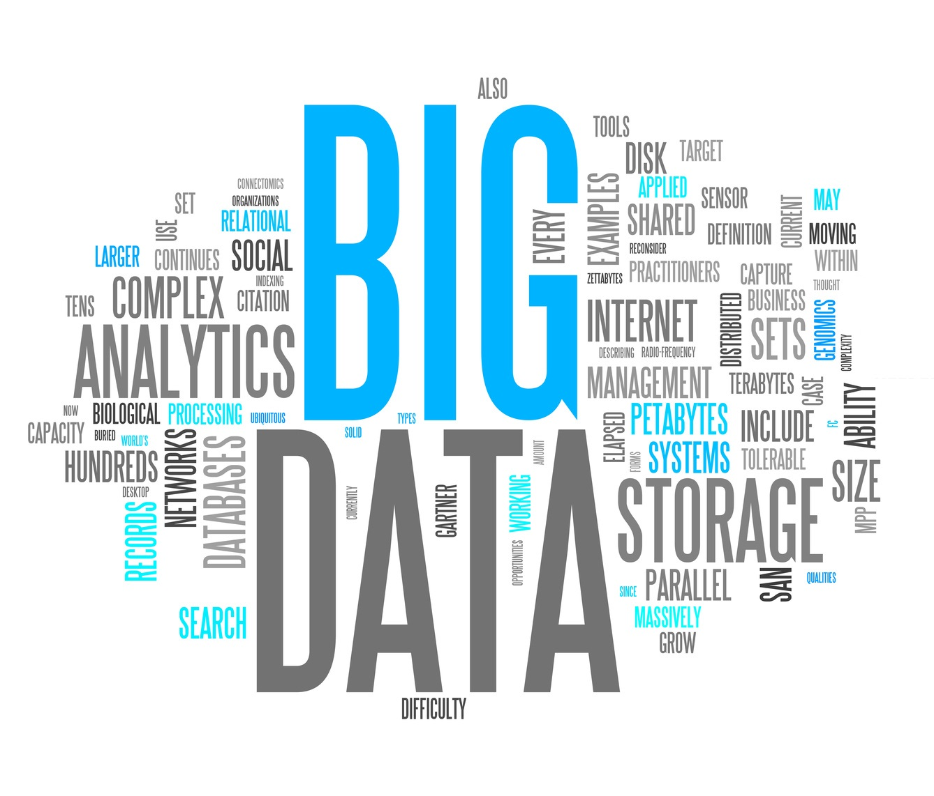
The Role of Data in the Successful Operation of Councils
By Aleksandar Peshev

Slide 2

What is data?
Text
Numerical
Data
Images
Videos

Slide 3
Introduction
Agenda for the presentation:
Definition of data.
Overview of the process of data collection and analysis.
Definition of planning and forecasting.
Evidence-based decision-making.
Service delivery optimization.
Performance monitoring.
Planning and forecasting.
Transparency and accountability.
Examples of common challenges faced by Councils when using data.

Slide 4

Introduction: Agenda for the presentation:
Overview of the process of data collection and analysis
Definition of data
2
1
Evidence-based decision-making
3
Service delivery optimization
Planning and Forecasting
5
4
Performance monitoring
6
7
Transparency and accountability
Examples of common challenges faced
by Councils when using data.
8

Slide 5

The definition of data
Types of data
Sources of data
Qualitative
Internal
Quantitative
External

Slide 6
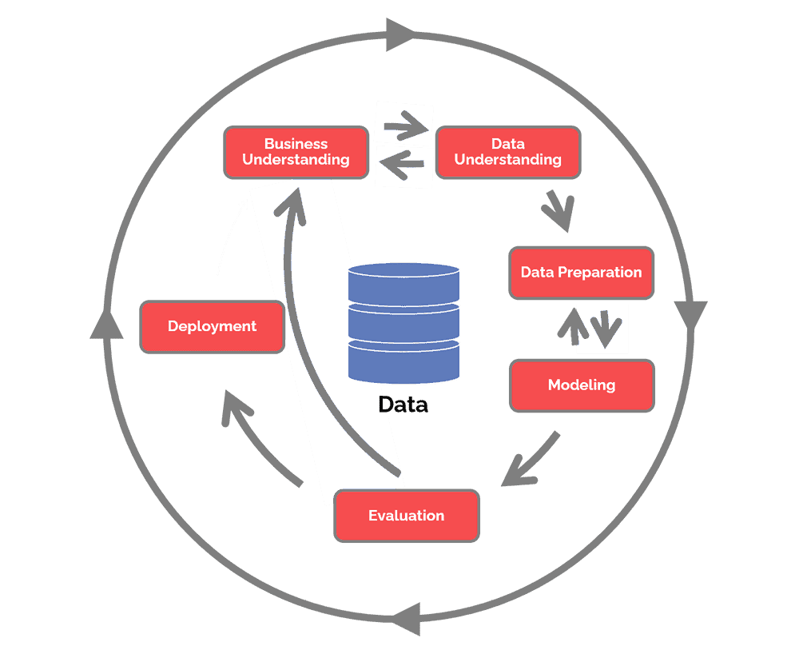
Data collection and analysis stages:
Defining the research
question
Tools and Techniques
Surveys
Data collection
Focus groups
Data cleaning
and processing
Statistical analysis
Data analysis
Machine learning:
Presentation of findings
Importance of data
quality and accuracy

Slide 7
Data collection and analysis
CRISP – DM
(Cross-Industry Standard Process for Data Mining

Slide 8
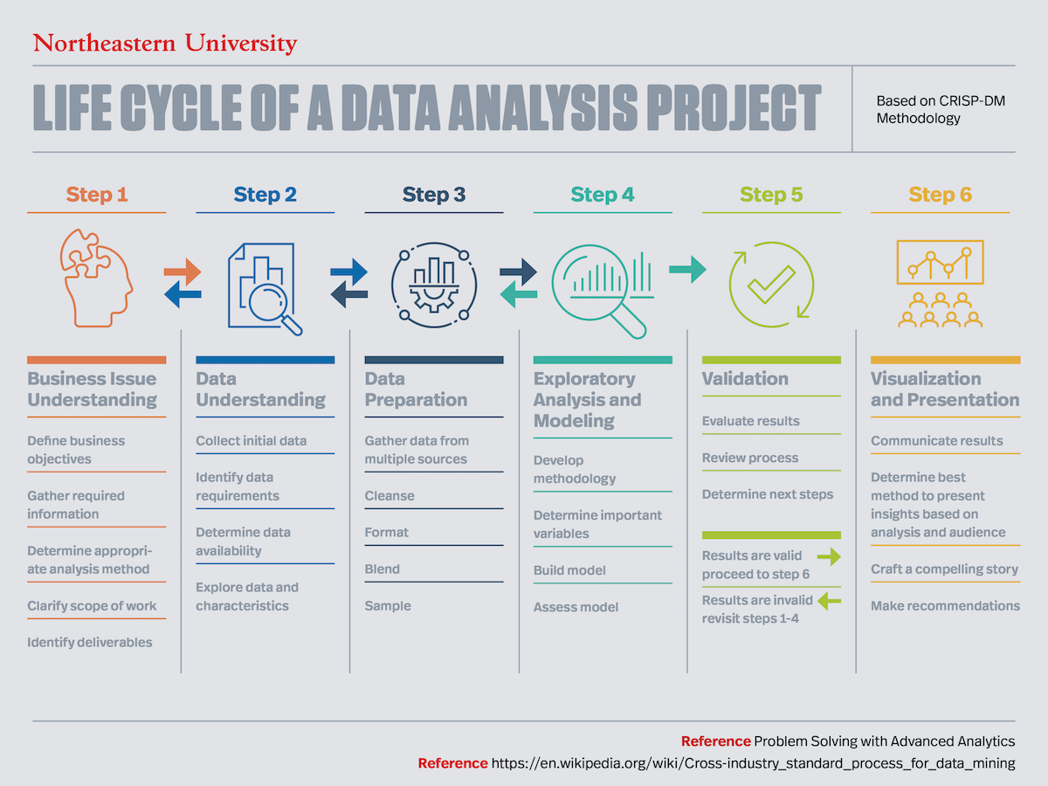

Slide 9

Evidence based
- Overview
- Importance of evidence-based decision-making
in Council operations
- Examples of how data can inform decision-making
in Council operations

Slide 10

Planning and Forecasting
- Overview
- Importance of planning and forecasting
in Council operations
- Examples of how data can help
Councils plan and forecast for the future

Slide 11

Service delivery optimization
- Overview
- Importance to the council’s operations
Examples of how data can help
optimize service delivery

Slide 12
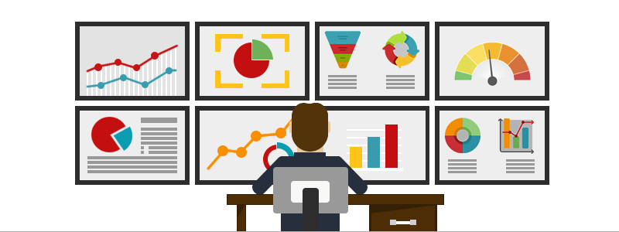
Performance monitoring
Overview of performance monitoring
Importance of performance monitoring
in Council operations
- Examples of performance indicators
that Councils can monitor

Slide 13
Transparency and Accountability
- Overview in the context of the council.
- Importance to the council’s operations.
Examples of how data can promote
transparency and accountability.

Slide 14

Challenges of using data in Council operations and addressing these challenges
- Data quality and accuracy
- Prioritizing data quality
- Breaking down data silos
- Access to data
- Focusing on KPIs
(key performance indicators)
- Analysis paralysis
- Resistance to change
- Emphasizing the value of data

Slide 15

Data plays a crucial role in Council operations.
Councils can use data for evidence-based decision-making, service delivery optimization, performance monitoring, transparency and accountability, and planning and forecasting.
Challenges in using data can be addressed with effective strategies.
Councils must prioritize the use of data to improve their operations and deliver better outcomes for their residents.
By embracing data-driven approaches, Councils can enhance their performance, promote public trust, and better serve their communities.

Slide 16


https://blog.minitab.com/en/what-is-data-a-beginners-guide-to-data-types-sources-and-analysis
https://blogs.lse.ac.uk/politicsandpolicy/what-is-evidence-based-policy-key-concepts-and-debates/
https://www.undp.org/content/undp/en/home/librarypage/poverty-reduction/using-data-for-evidence-based-decision-making.html
https://www.govloop.com/resources/optimizing-service-delivery-through-data-analytics/
https://www.opuscapita.com/service-delivery-optimization
https://icma.org/articles/pm-magazine/performance-management-local-government
https://www.smartsheet.com/content/performance-monitoring-importance
https://www.oecd.org/gov/transparency-and-accountability.htm
https://www.govloop.com/resources/using-open-data-increase-government-transparency-accountability/
https://www.oracle.com/analytics/what-is-planning-and-forecasting/
https://www.thehartford.com/business-insurance/strategy/importance-of-planning-in-business
https://www.investopedia.com/terms/d/data-collection-and-analysis-methods.asp
https://www.edq.com/blog/importance-of-data-quality-data-accuracy/
https://www2.deloitte.com/us/en/insights/industry/public-sector/challenges-data-driven-government.html
https://www.cioreview.com/news/common-data-challenges-and-solutions-nid-26885-cid-22.html

Slide 17
https://blog.minitab.com/en/what-is-data-a-beginners-guide-to-data-types-sources-and-analysis
https://blogs.lse.ac.uk/politicsandpolicy/what-is-evidence-based-policy-key-concepts-and-debates/
https://www.undp.org/content/undp/en/home/librarypage/poverty-reduction/using-data-for-evidence-based-decision-making.html
https://www.govloop.com/resources/optimizing-service-delivery-through-data-analytics/
https://www.opuscapita.com/service-delivery-optimization
https://icma.org/articles/pm-magazine/performance-management-local-government
https://www.smartsheet.com/content/performance-monitoring-importance
https://www.oecd.org/gov/transparency-and-accountability.htm
https://www.govloop.com/resources/using-open-data-increase-government-transparency-accountability/
https://www.oracle.com/analytics/what-is-planning-and-forecasting/
https://www.thehartford.com/business-insurance/strategy/importance-of-planning-in-business
https://www.investopedia.com/terms/d/data-collection-and-analysis-methods.asp
https://www.edq.com/blog/importance-of-data-quality-data-accuracy/
https://www2.deloitte.com/us/en/insights/industry/public-sector/challenges-data-driven-government.html
https://www.cioreview.com/news/common-data-challenges-and-solutions-nid-26885-cid-22.html

Slide 18



